Slide 1

Smart Power Quality Analyzer
An high-accuracy, internet-enabled instrumentation platform for electrical harmonics and metrics analysis.
DESIGNED BY ELECTROSQUAD
Anthony C.S.B. (230045X)
Chandrakumara H.A.D.C. (230100M)
Hansindu M.M.A.D. (230229P)
Perera H.A.J.I. (230477X)
Weerasinghe J.A.H.R. (230697V)

Slide 2


Problem & Objectives
Power Quality Degradation
The LKR 350,000+ Barrier
Voltage fluctuations, sags, swells, and frequency drift compromise sensitive hardware across commercial and educational grids.
Commercial high-end power analyzers range from LKR 350,000 to 1,750,000, making them completely unaffordable for SMEs and laboratories.
Nonlinear loads generate high harmonic currents, leading to excessive thermal stresses, power grid losses, and equipment failure.
Goal: Engineering a low-cost, high-precision analyzer displaying local FFT data and providing remote telemetry at a fraction of the cost.

Slide 3

Technical Specifications
Parameter | Device Specification | Details & Protocol
System Type | Single-Phase Power-Quality Analyzer | Designed for industrial/domestic monitoring
Nominal Grid Voltages | 230 V AC nominal | 0 - 300 V AC Range | Adapts to broad fluctuation limits
Nominal Line Frequency | 50 Hz Base Frequency | Real-time detection and logging
Current Measurement Range | 0 to 50 A max measurement limit | SCT-013-050 non-invasive sensor support
Harmonics Analysis range | 1st to 25th Harmonic Order (H1 to H25) | High-speed simultaneous sampling FFT
MCU Inter-comm Rate | 921,600 bps high-speed UART link | Minimal packet delivery latency (DMA-backed)
Wireless Link & DB | 2.4 GHz Wi-Fi to Firebase Cloud Platform | Live database sync and historic CSV tracking

Slide 4





System Architecture
Sensing & Isolation
Acquisition & processing
Interface & Telemetry
Voltage: High-precision divider mapped to an isolated AMC1301 amplifier.
16-bit external ADS8588 ADC reads signals concurrently over SPI at 10 kHz.
ESP32-S3 parses packet arrays over 921,600 bps UART.
Current: SCT-013-050 sensor provides galvanic isolation with precise burden calibration.
STM32F411 processes 1024-point frames using CMSIS-DSP to calculate RMS, THD, and FFT.
Drives localized 7" touch TFT screen and streams encrypted telemetry into Firebase Realtime Database.

Slide 5
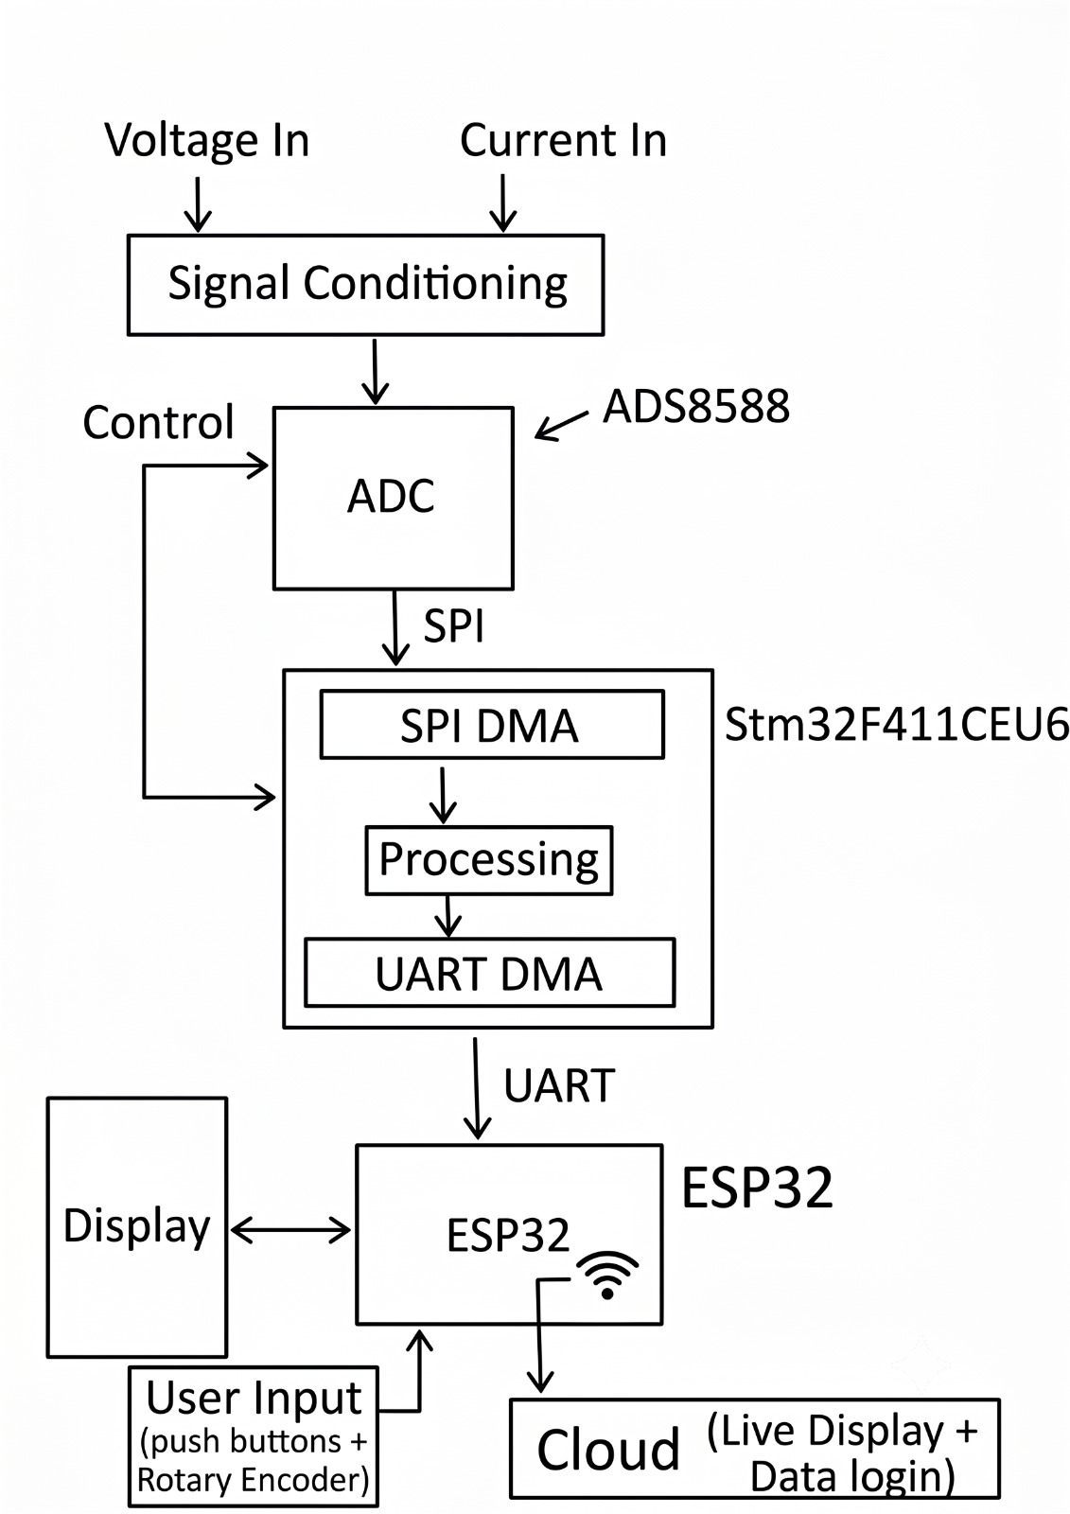
System Architecture

Slide 6

Hardware: PCB Design
Signal Isolation Schemes
Traces, Filters, and Grounds
To safely bridge high 230V AC mains voltage to low-voltage MCU digital rails, we integrated AMC1301 isolation amplifiers.
Dedicated two-layer board design with solid independent analog/digital ground fills to prevent high-frequency noise insertion.
The layout enforces a clear physical gap between primary high-voltage areas and sensitive signal processing traces.
All ADC inputs include inline RC decoupling networks to protect the external 16-bit ADS8588 analog pins from signal reflection.

Slide 7
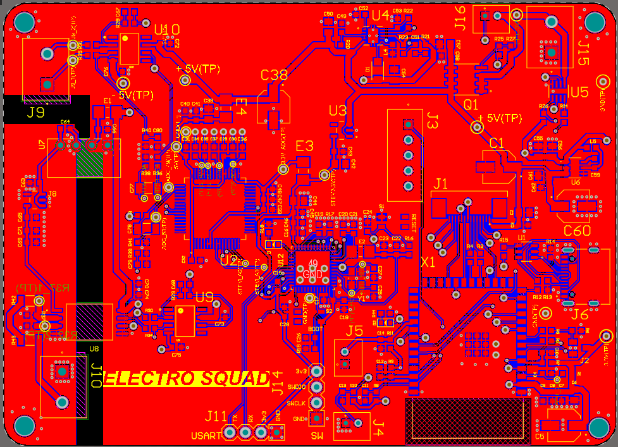
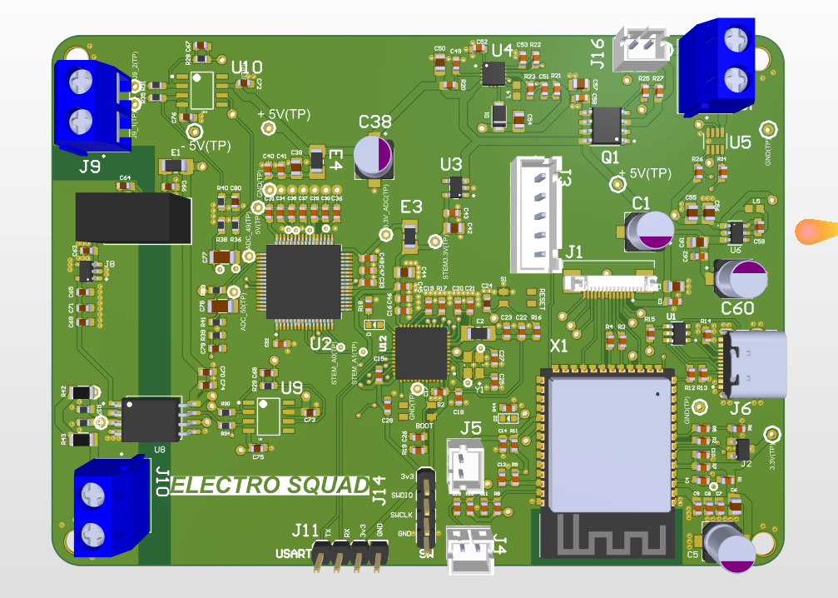
Hardware: PCB Design
Front View - 2D
Front View - 3D

Slide 8

Hardware: Enclosure
Mechanics & Sizing
Human-Machine Interfaces
Form Factor: Highly durable, compact desk-ready enclosure matching industrial workbench criteria.
Local Screen: Center-mounted high-contrast TFT color touchscreen powered via an FT6336 controller.
Dimensions: 9 inches width, 6 inches height, and a 2.5 inches depth profile.
Tactile Controls: Hardwired rotary encoder and dedicated push-buttons for logging control and screen navigation.
Safety Integration: Features integrated ventilation slots for cooling, keeping standard system temperatures low.

Slide 9
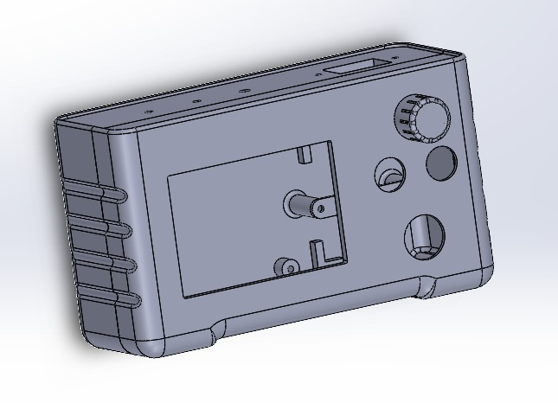
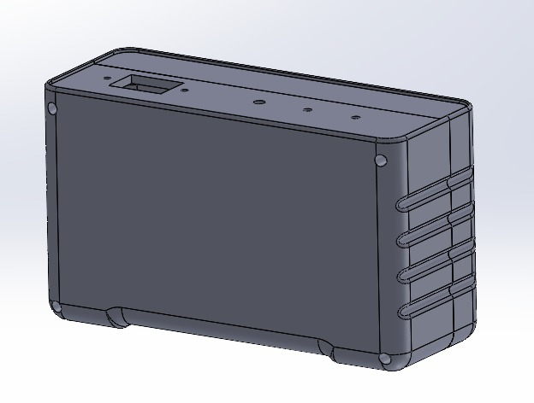
Hardware: Enclosure
Front View
Back View

Slide 10
Firmware & Processing
Simultaneous 10 kHz Sampling: SPI interface driven by DMA sweeps external 16-bit ADS8588 analog values at precise intervals to guarantee zero phase delays between signals.
CMSIS-DSP Execution: The STM32F411 processes 1024 raw data samples every 102.4 ms, using hardware floating-point acceleration to maintain strict real-time deadlines.
Parametric Calculations: Computes real-time True RMS Voltages, Currents, Active Power, Reactive Power, Apparent Power, Supply Frequency, and Power Factor.
Harmonics & THD: Solves 25-point FFT decompositions on voltage and current profiles, calculating precise Total Harmonic Distortion (THD) ratios up to order H25.

Slide 11
IoT Cloud Dashboard
Real-Time IoT Telemetry
Session Archives & Analysis
Using Vite, React, and TypeScript, the web dashboard displays real-time system metrics directly from Firebase Realtime Database.
The dashboard lists all historical test periods synced from the analyzer's local storage.
Enables single-click downloads of complete measurements in CSV format, facilitating immediate integration with MATLAB or Excel.
Automatically triggers visual alerts and warning codes if voltage sags, swells, or high THD conditions are detected.

Slide 12
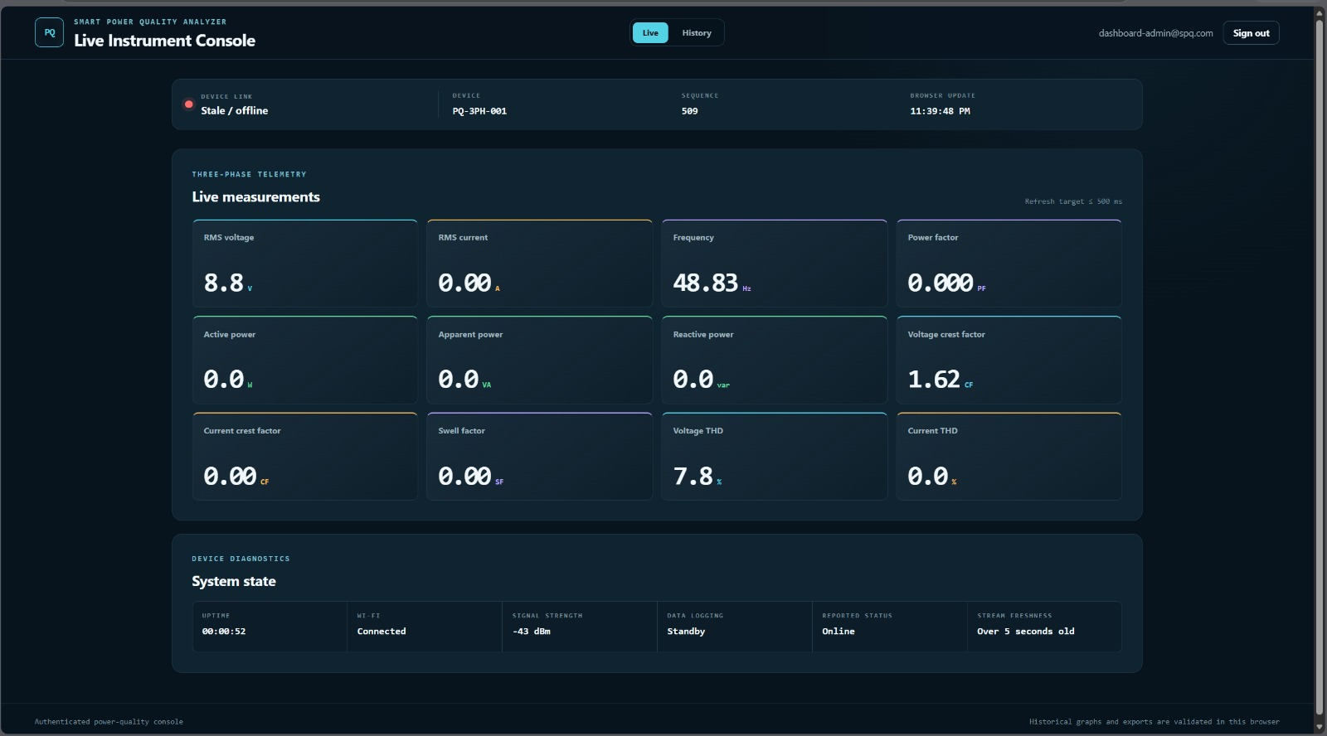
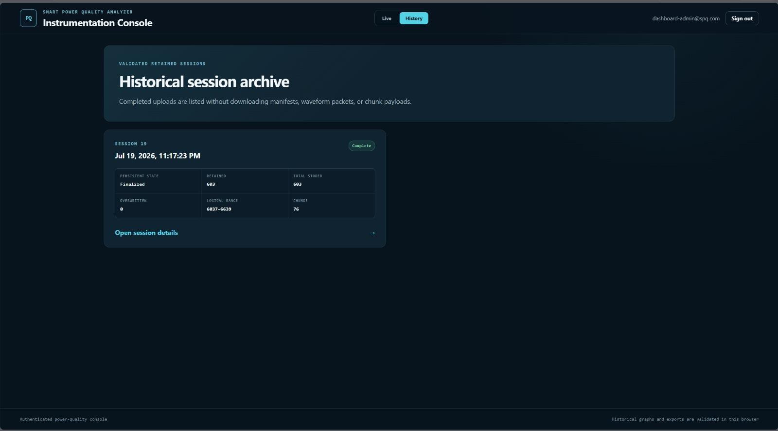
IoT Cloud Dashboard

Slide 13
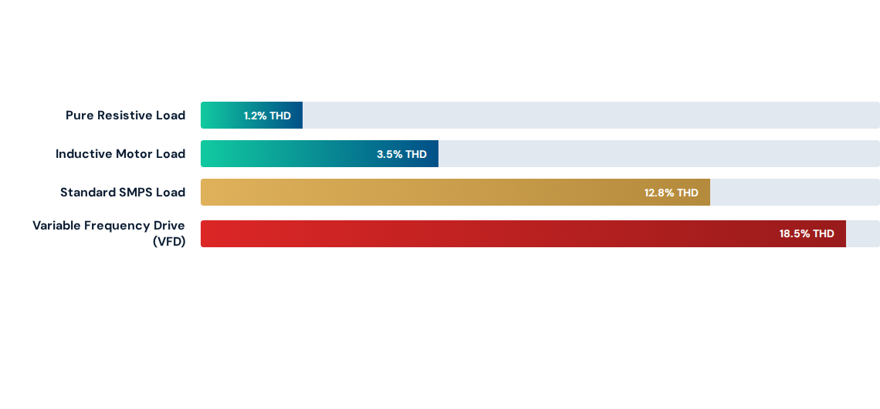
Harmonics & Distortion
The analyzer successfully isolates and tracks dominant 3rd, 5th, and 7th harmonic profiles, aligning precisely with high-end commercial references under heavy distortion loads.

Slide 14


Project Budget & Costing
No. | Bill of Quantities (BoQ) | Cost (LKR)
1 | General Electronic Components | 12,773
2 | 7" Color TFT Display Module | 6,000
3 | Cables, Terminals, Connectors | 2,000
4 | Enclosure Assembly Parts | 3,000
5 | AC-DC Isolated Supply Module | 1,450
6 | Two-Layer PCB Manufacturing | 8,000
- | Estimated Total Cost | 33,223
Total Cost Equation
Our target selling price of $300 (~LKR 90,000) delivers a highly viable profit margin while undercutting commercial analyzers by over 70%.

Slide 15



Market Readiness Metrics
Safety Compliance
Enclosure Durability
Target Markets
Fully compliant with IEC 61000 and IEEE 1159 electrical safety guidelines.
Constructed with flame-retardant structural plastic.
An ideal tool for educational laboratories, SMEs, and grid technicians.
High dielectric barrier protection ensures complete low-voltage user isolation during mains failures.
Compact, durable desktop form factor with optimized air ventilation allows for reliable continuous operation.
Enables affordable energy audits and continuous power quality assessment.

Slide 16
Conclusion & Future Work
Project Milestones Achieved: Realized a highly accurate, internet-enabled, single-phase analyzer. Successfully completed all hardware isolation tests and remote dashboard streaming pipelines.
Three-Phase Expansion: Upgrading core hardware to enable simultaneous, high-precision measurement of three-phase voltage and current lines.
Cloud Analytics & Alerts: Integrating serverless machine learning loops to automatically classify power quality issues (sags, swells, transients) and alert operators.
Mobile App Ecosystem: Developing dedicated Android and iOS companion apps using Bluetooth and local Wi-Fi for quick on-the-go checks.

Slide 17
THANK YOU
ELECTROSQUAD

